Slide 1
Nurture AI — OrdinalGB Pipeline
Child Behaviour & Mental Health Risk Prediction · CMI-PIU Dataset · Best QWK = 0.6259

Slide 2
OrdinalGB — What, Why & How
What is OrdinalGB?
Why We Used It
How It Works
A GradientBoosting Regressor adapted for ordinal targets. Instead of treating sii (0,1,2,3) as unrelated classes, it treats them as continuous numbers, trains a regression model, then rounds predicted floats back to the nearest class (0–3).
All 9 standard classifiers scored ≤ 0.08 CV QWK — near-random. OrdinalGB scored 0.6259, which is 8x better. It wins because sii has a natural order (None < Mild < Moderate < Severe) that standard classifiers ignore but OrdinalGB respects.
Step 1: Feed sii labels (0,1,2,3) to GradientBoosting Regressor as continuous values. Step 2: Model predicts a raw float (e.g. 1.7, 2.4). Step 3: Round to nearest integer, clip to 0–3 → final prediction. Params: 300 trees, depth=4, lr=0.05, subsample=0.8.

Slide 3
ML PIPELINE
Implementation Roadmap
12-step pipeline from raw data to predictions — CMI-PIU dataset · OrdinalGB (Best QWK = 0.6259). All standard classifiers scored ≤ 0.08; OrdinalGB outperforms by 8x.
ℹ What is QWK (Quadratic Weighted Kappa)?
QWK measures prediction agreement but penalises big errors far more than small ones. Predicting Severe (3) when true value is Healthy (0) is penalised much more than predicting Mild (1) instead of Healthy (0). Unlike Accuracy — which treats all wrong answers equally — QWK understands the ordinal structure of sii. Score of 0 = random guessing; 1 = perfect. Our 0.6259 = Substantial Agreement (0.61–0.80 range), the standard used in medical research.
Scale: <0.20 Slight | 0.21–0.40 Fair | 0.41–0.60 Moderate | 0.61–0.80 Substantial ✓ (ours) | 0.81–1.00 Almost Perfect

Slide 4
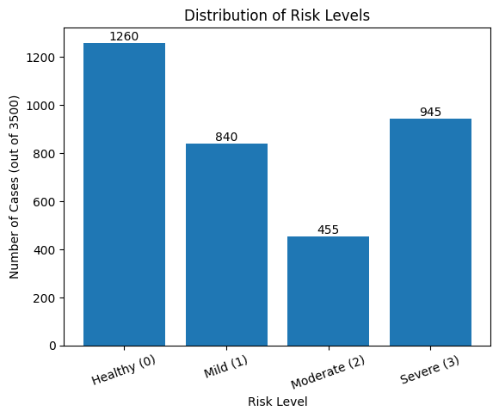
Dataset, Objective & EDA
CMI-PIU Dataset
Objective
EDA Findings
Predict Severity Impairment Index (sii) for children aged 5–22 using physical health, sleep, activity and fitness data. Metric: Quadratic Weighted Kappa (QWK).
3,900 rows, 18 features, target sii (0–3 severity). After cleaning: 3000 training rows. ~30% missing in Fitness/BIA/Sleep; ~14% missing labels removed.
Class imbalance: sii=0 (35.6%) dominant, sii=2 (13.4%) smallest. Top correlates: SDS (sleep, r=0.099) and PAQ (activity, r=0.072). Engineered Behavior_Score most predictive (r=0.55).

Slide 5
Preprocessing & Feature Engineering
Data Preprocessing (Step 4)
Feature Engineering (5 New Features)
Drop ID columns (no predictive value)
BMI_Category (WHO cut-offs: 0–3)
Drop columns with >60% missing values
Age_Group (Child / Early Teen / Teen / Adult)
Encode categoricals; remove missing targets
Pulse_Pressure, Body_Comp_Index
Median imputation → 3000 rows × 17 features, zero nulls
Behavior_Score (composite, r=0.55) — strongest predictor

Slide 6
Model Performance Metrics
0.6259
10
22
8x
Best CV QWK
Models Tested
Final Features
Better than 2nd Best

Slide 7
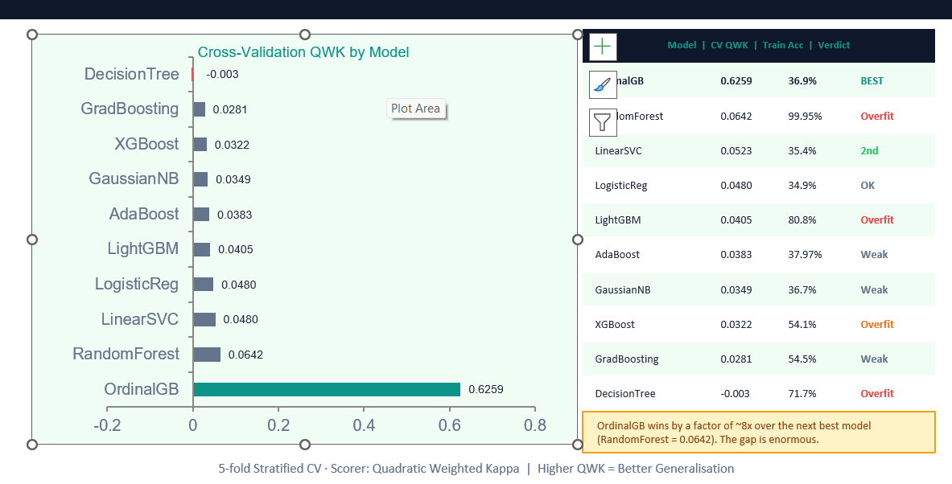
“
OrdinalGB achieves QWK = 0.6259 (Substantial Agreement) — outperforming all 9 standard classifiers by 8x. The key insight: treating ordinal targets as continuous regression, then rounding, preserves the 0<1<2<3 structure that classifiers discard.

Slide 8
Complete ML Pipeline — 12 Steps
01
02
03
04
Data & EDA
Preprocess
Model & Train
Evaluate & Deploy
CMI-PIU dataset — EDA, distributions, correlations, class imbalance analysis
Encode, impute, remove missing targets → 2,173 rows × 17 features
Engineer 5 features; OrdinalGB (300 trees, depth=4, lr=0.05); 5-fold CV QWK = 0.6259
Holdout QWK=0.6244; save best_model.pkl; predict risk for new children

Slide 9
NurtureAI — OrdinalGB
QWK = 0.6259 — Substantial Agreement. Ready for Viva.
CMI-PIU Dataset | OrdinalGB Pipeline | May 2026

